Slide 1
Office 365 Development

Slide 2
Course Agenda
Deep Dive into the Building Blocks and Services of the SharePoint Platform
Module 1: Developing Advanced Workflow Scenarios in Office 365
Module 2: Deep Dive into SharePoint Lists for Data Storage
Module 3: Deep Dive into SharePoint Lists with REST APIs
Module 4: Deep Dive into SharePoint Lists with CSOM APIs
Module 5: SharePoint 2013 Remote Event Receivers
Module 6: Deep Dive into Search Scenarios in Office 365
Module 7: Deep Dive into Business Connectivity Services in Office 365
Module 8: Developing Advanced Taxonomy Scenarios in Office 365

Slide 3
Deep Dive into SharePoint Lists with REST APIs

Slide 4

Agenda
Intro
Understanding REST & OData
REST Supported Data Types
Querying Data
Form / Security Digest
Creating Data
Updating & Deleting Data
Resources

Slide 5
Overview

Slide 6















Vision
EXTEND OFFICE EVERYWHERE
CONNECT TO OFFICE 365 SERVICES
BUILD USING AN OPEN PLATFORM
Delve
z
Users and groups
Files
Mail
Calendar
My Apps
Video Portal
Contacts
Office Graph
Presentations
Documents
Spreadsheets
Lync
OneNote
Yammer

Slide 7

SharePoint App Building Blocks
SharePoint Apps
aspx
Databases
png
master
CSS
js
Web Services
SharePoint
REST
CSOM
SharePoint API
Managed
Metadata
Search
Service
Workflow
Service
BCS
List and Libraries
Service Applications

Slide 8
What – REST API
Introduced for lists in SharePoint 2010
Revamped & Improved in SharePoint 2013
One of two endpoints available to developers
Can be called from client / server side solutions
Enables low-level interaction with SharePoint services
Includes most of the things CSOM covers
Founded on the OData v3.0 protocol specification
Notes:
Introduced in SharePoint 2010
/_vit_bin/listdata.svc
provided read/write access to SharePoint lists
still present but only for backcompat reasons… don’t use this in greenfield dev
Revamped in SharePoint 2013
/_api
Expanded from read/write on SharePoint lists to do more with lists, sites & artifacts
Supports the OAuth2 authentication & app permissions
REST API is one of two endpoints available for remotely interacting with SharePoint
Can be called from client-side solutions (browser) or server-side solutions off the SharePoint server
Enables low-level interaction with SharePoint services
Includes most of the same things CSOM includes
lacking - Taxonomy & Workflow Services
Founded on OData v3.0 spec
predictable

Slide 9
Why – REST API
Why two options for remote endpoints (CSOM & REST)?
Not all CSOM implementations have SDKs for the CSOM (mobile & server side platforms)
CSOM requires knowledge of SharePoint-specific concepts
REST is a web standard many web developers understand & are familiar with
SharePoint’s REST API is founded on OData for predictable endpoints & usages
Notes:
Why two options for remote endpoints
CSOM & REST?CSOM implementations
Managed - .NET & Silverlight
JSOM
Implementations in the form of SDK libraries (.DLL & *.JS)
Not all tech has a SDK
Mobile platforms (iOS, Windows Phone, Android)
Common server platforms (Java, PHP, NodeJS)
CSOM requires some knowledge of SharePoint specific concepts
Client context
load & loadquery
execution scopes
REST is a web standard so any developer familiar with REST should be good
minimal SharePoint requirements
form digest
predictable queries using OData grammar

Slide 10
Overview of the REST API
Common endpoint:
http://[sharepoint-site]/_api
Access to sites, lists, users, search…
Supports OAuth 2.0 for authentication & SharePoint app permissions
Common endpoints:
http://[..]/_api/web
http://[..]/_api/web/lists
http://[..]/_api/web/lists/GetByTitle(‘Contacts’)
http://[..]/_api/web/lists/GetByTitle(‘Contacts’)/items

Slide 11
REST API & OData
REST is a concept, introduced in 1970s
http://en.wikipedia.org/wiki/Representational_state_transfer
Outlines how data can be exchanged over the World Wide Web
OData is an open & ratified protocol based on REST
http://www.odata.org
Defines specific data format submissions & responses
Defines set grammar & vocabularies for communicating with services
Self describing with dynamic metadata endpoint
SharePoint 2013 & SharePoint Online mostly support the entire OData 3.0 protocol spec

Slide 12
OData in SharePoint
All endpoints are canonical URLs
Absolute URL endpoint to a collection (entitySet) or item (entity)
Sometimes multiple paths lead to the same thing
http://[..]/_api/web/lists/list(‘guid’)
http://[..]/_api/web/lists/getbytitle(‘Contacts’)
Responses are self describing
Show relationships between other entities or child collections

Slide 13
REST API & Supported Data Formats

Slide 14
Supported REST Data Formats
XML
Mime type: application/atom+xml
Typically larger payload response than JSON
Can be used to submit or retrieve data
Client-side & server-side SDKs available to help in parsing & construction
JSON
Mime type: application/json;odata=verbose
OData 3.0 protocol supports the JSON verbose format
OData 4.0 protocol supports JSON light & minimal medata
Typically smaller payload response than XML
Can be used to submit or retrieve data
Client-side & server-side SDKs available to help in parsing & construction

Slide 15
Controlling Data Submitted / Requested
Specify data format sent to the service:
Content-Type: application/atom+xml
Content-Type: application/json;odata=verbose
Specify data format returned when submitting requests:
Accept: application/atom+xml
Accept: application/json;odata=verbose

Slide 16
Querying Data from REST Services

Slide 17
Querying Data from REST Services
Always include:
HTTP GET
Endpoint of the resource to return
Headers for authentication & data format requested
Control the query using OData operators on the query string:
$select: tell the service to only return specific fields
$orderby: sort the returned data by a specific field
$filter: use like a where clause
$filter=CompanyName eq ‘Contoso’
$filter=substring(CompanyName,1,2) eq ‘Co’

Slide 18
demo
Querying Data from ReST Services

Slide 19
Creating, Updating & Deleting Data with REST Services

Slide 20
Form / Security Digest
SharePoint includes protection from the replay attack
http://en.wikipedia.org/wiki/Replay_attack
Must include a security digest in all non-GET HTTP requests in the X-RequestDigest header
Digest is good for 30 minutes before expiring
Obtaining the digest
Included in hidden form field __RequestDigest on all SharePoint pages
Submit HTTP POST to http://[..]/_api/contextinfo

Slide 21
Creating Data with REST Services
Submit HTTP request as a POST
Endpoint of request is the EntitySet where it should be created
Body of the request contains the data (XML / JSON) to be used in creating the entity
Include additional headings
Content-Type, Content-Length & X-RequestDigest
Service responds with resulting entity & HTTP 201

Slide 22
Updating Data with REST Services
Submit request one of two ways:
HTTP PATCH or HTTP POST with header X-Http-Method=Merge if PATCH not supported by a client
Endpoint of request is the Entity to be updated
Body of the request contains the data (XML / JSON) to be used in creating the entity
Include additional headings
Content-Type, Content-Length & X-RequestDigest
Service responds with HTTP 200 on success

Slide 23
Updating Data & Versioning
Should always include a header If-Match=[#]
Tells the server “update the entity if it is version #”
If not, you are updating an old version
Service response with HTTP 419 – Precondition Failed
All OData responses include an Etag, the version number of the Entity on the server
Applies to update & delete operations
Can pass * to say “match any version”
Should only ever use this in delete operations; never in updates

Slide 24
Deleting Data with REST Services
Submit HTTP Request as DELETE
Endpoint of request is the Entity to be deleted
Include additional heading X-RequestDigest
Content-Type & Content-Length not necessary
Service responds with HTTP 200 on success

Slide 25
demo
Creating, Updating & Deleting Data With ReST Services

Slide 26
Resources
Office 365 Development Overview

Slide 27
REST API Resources
SharePoint REST API Reference & Samples
http://msdn.microsoft.com/en-us/library/office/jj860569(v=office.15).aspx
OData
http://www.odata.org
http://www.odata.org/documentation/odata-version-3-0/url-conventions

Slide 28
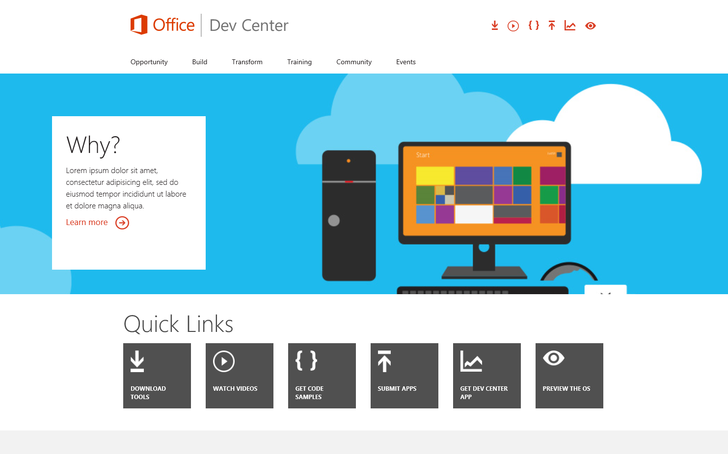
Office 365 Developer Center
dev.Office.com
Opportunity
Build
Transform
Code Samples
Patterns & Practices
API Reference
Community

Slide 29
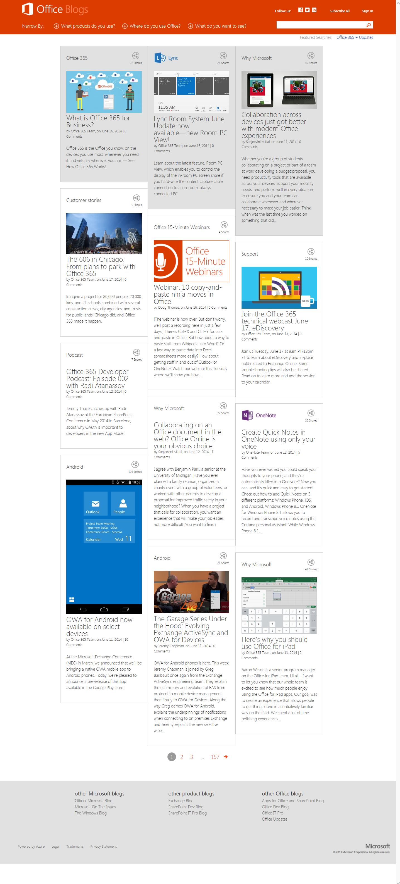
Office Blogs
Office 365 news
Dev announcements
Events
Garage Series videos
Weekly podcast

Slide 30
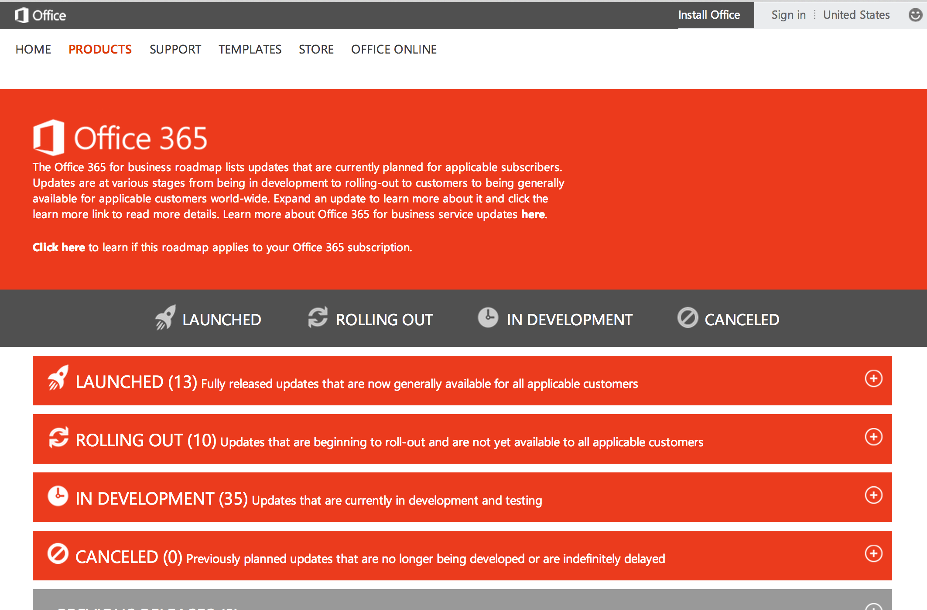
Roadmap
Monthly updates
Developer features
Associated blog posts

Slide 31
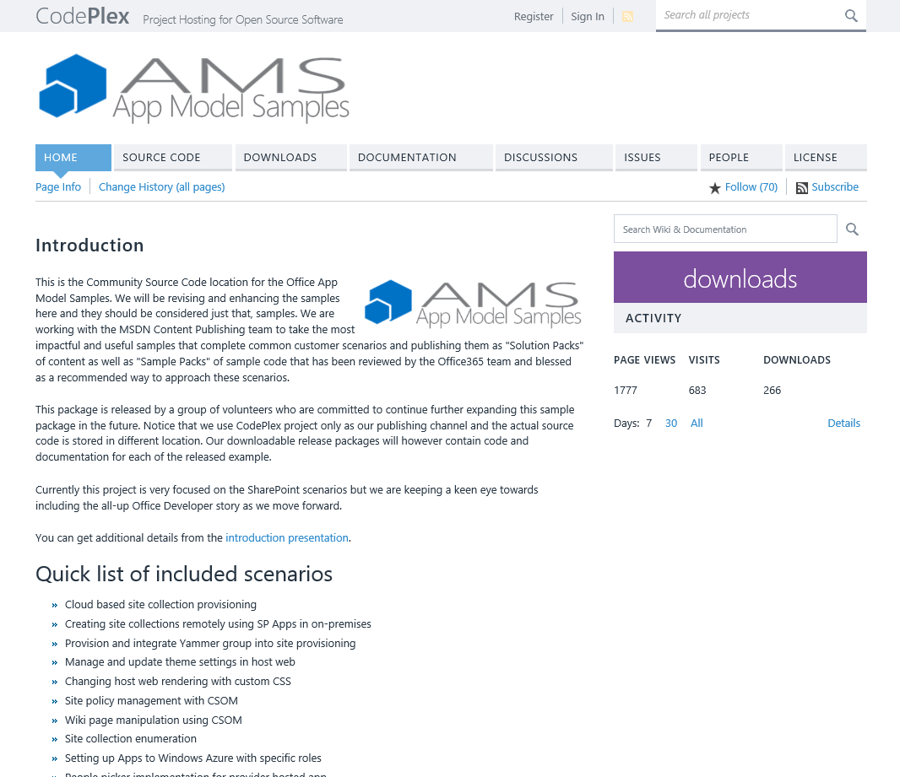
Patterns & Practices
Providing App Model Patterns for common Full Trust Code scenarios
30+ Visual Studio Projects
Common scenarios
Branding
Site Provisioning
Remote Event Receivers
Large file support
Taxonomy driven navigation
And much more…
Contribute
Open source coming soon!

Slide 32
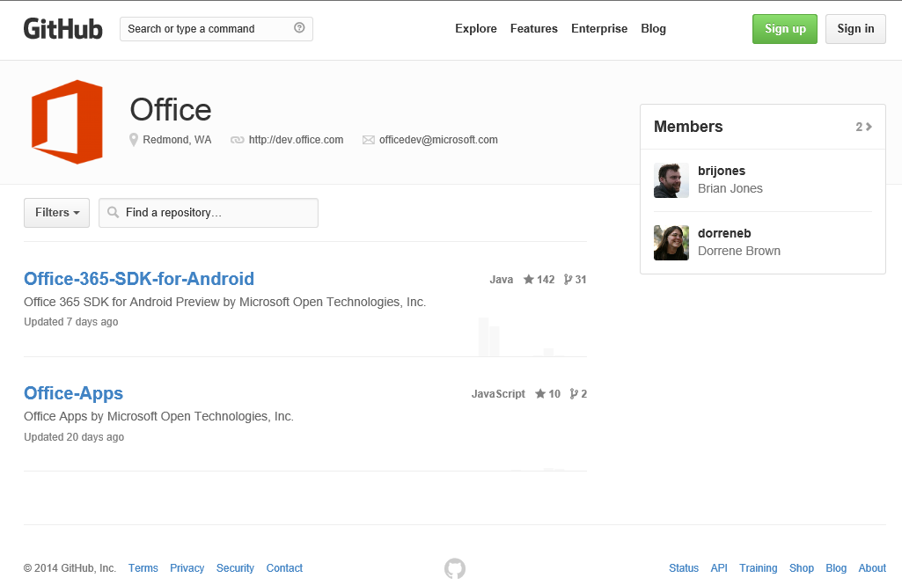
GitHub
Github.com/OfficeDev
SDKs
Android SDK
Code Samples
WikiPedia App for Word
Campaign Manager for Android
Expense Manager for Windows 8
Research Manager inc. AngularJS
Building Snippets for Word
Contribute
We want your enhancements and your samples!

Slide 33
Courses
Deep Dive into the Building Blocks and Services of the SharePoint Platform
Module 1: Developing Advanced Workflow Scenarios in Office 365
Module 2: Deep Dive into SharePoint Lists for Data Storage
Module 3: Deep Dive into SharePoint Lists with REST APIs
Module 4: Deep Dive into SharePoint Lists with CSOM APIs
Module 5: SharePoint 2013 Remote Event Receivers
Module 6: Deep Dive into Search Scenarios in Office 365
Module 7: Deep Dive into Business Connectivity Services in Office 365
Module 8: Developing Advanced Taxonomy Scenarios in Office 365

Slide 34
Summary
Intro
Understanding REST & OData
REST Supported Data Types
Querying Data
Form / Security Digest
Creating Data
Updating & Deleting Data
Resources

Slide 35


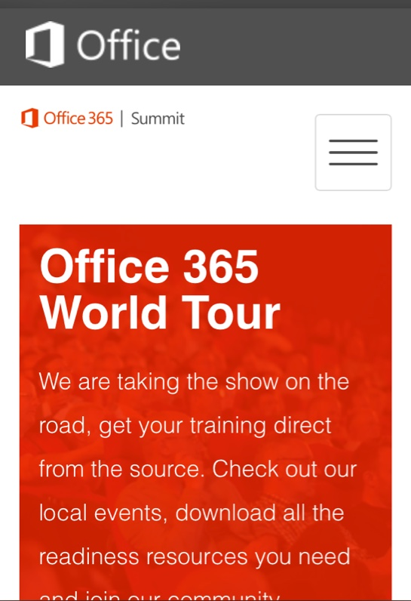
dev.office.com
Sign up
http://dev.office.com/getting-started
Explore
http://apisandbox.msdn.microsoft.com
Get trained http://dev.office.com/training

Slide 36


Feedback
Office 365 Network Share you best practices and join conversations https://www.yammer.com/itpronetwork
Stackoverflow Ask deep technical questions to a world-wide set of developers
http://stackoverflow.com/questions/tagged/ms-office
UserVoice Provide suggestions of what you want in future versions
http://officespdev.uservoice.com/

